Slide 1
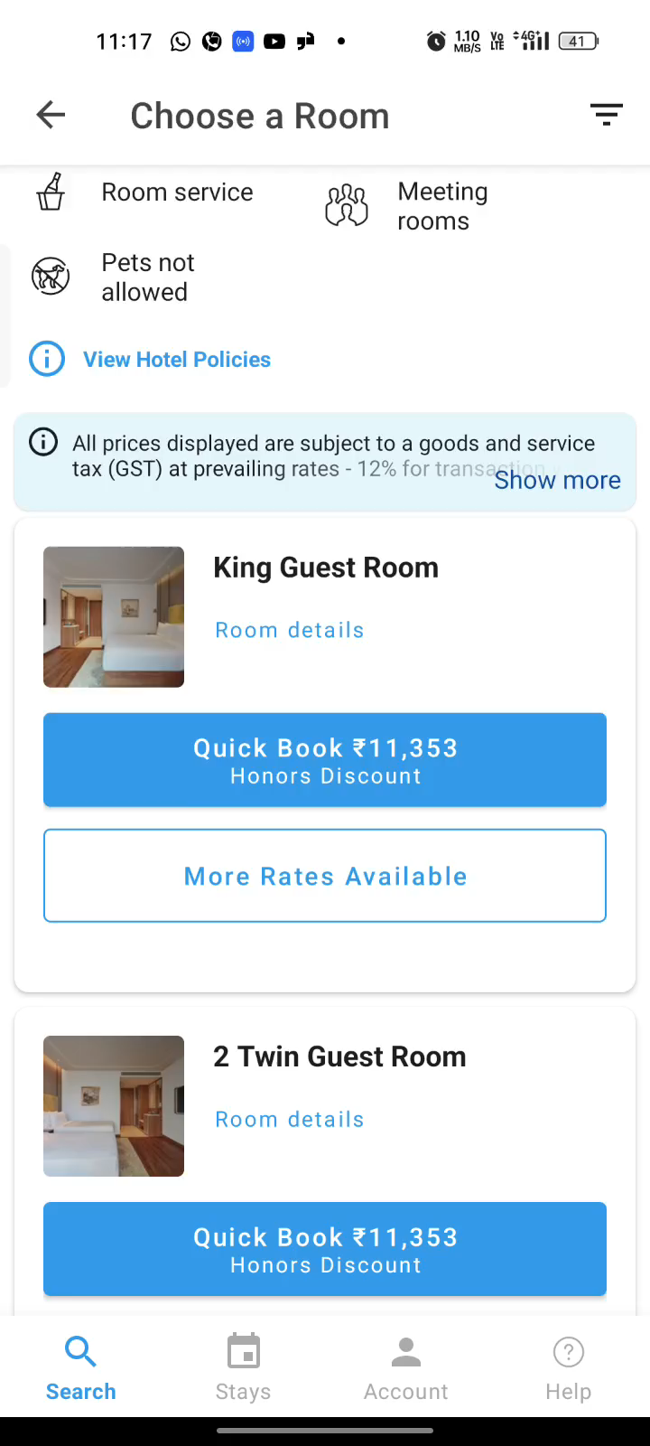
Missing Room Images in Selection Flow & Lag in Room Details
Missing Room Images in Selection Flow
While every property has images displayed on the main listing, selecting a specific room in the “Room Details” section shows no corresponding room images.
This creates confusion for the customer, who cannot visualize the selected room.
Even when detailed room information is provided, images would help users make quicker and more confident decisions.
Lag in Room Details section
Upon opening the “Room Details” section, the sub-sections — “For Your Comfort,” “For Your Convenience,” and “For Your Confidence” — take 1–2 seconds to load.
This lag creates an inconsistent user experience and may result in users missing key information, especially if they navigate away quickly.
Lag in Room Details video
**All observations are for an Android device

Slide 2
Recommendations & Next Steps
Incorrect Location selection
Simplify the experience by allowing users to select the region where they want to browse specific hotel types or features. If no hotels are available for the selected criteria, display a clear message informing the user upfront.
Currency Inconsistency
Resolve inconsistencies in pricing formats by standardizing the currency shown for hotels within the same location. Additionally, provide users with the option to choose their preferred currency for a more transparent experience.
Missing Room Images in Selection Flow & Lag in “Room Details” section
Include images and videos for individual rooms within the “Room Details” section. Also, address the lag observed when loading sections such as “For Your Comfort” or “For Your Convenience” to improve responsiveness.
Note: Implement each recommendation one at a time and use A/B testing to measure its impact on business metrics and user experience
**All observations are for an Android device

Slide 3
Thank You!

